Slide 1
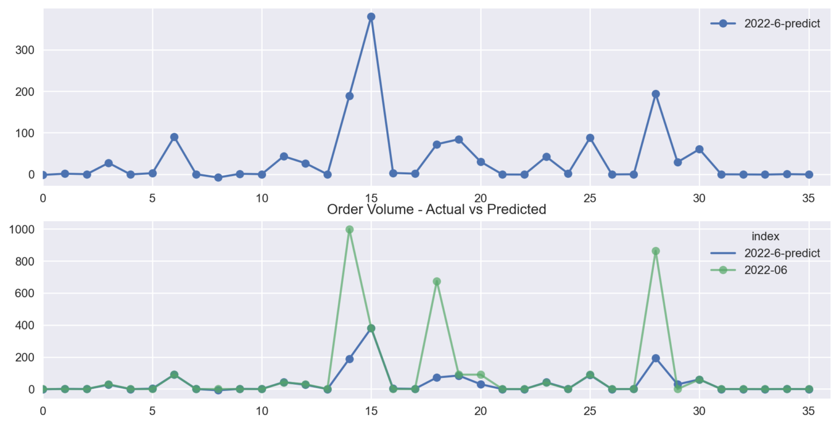
RSBU – PA 2022-6 Actual vs Predicted

Slide 2
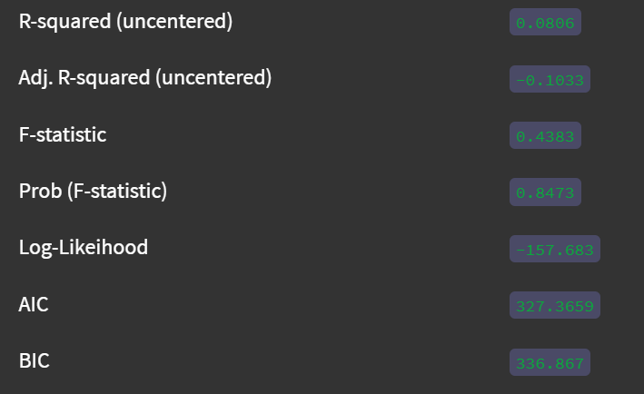
RSBU – PA 2022-7 Predict Summary

Slide 3
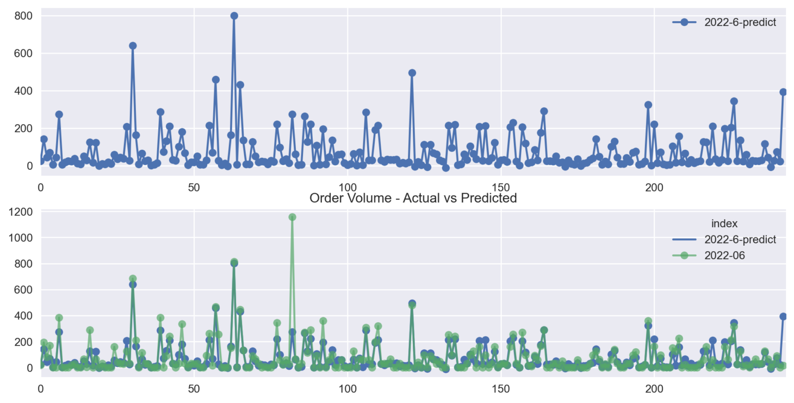
RSBU – PZ 2022-6 Actual vs Predicted

Slide 4
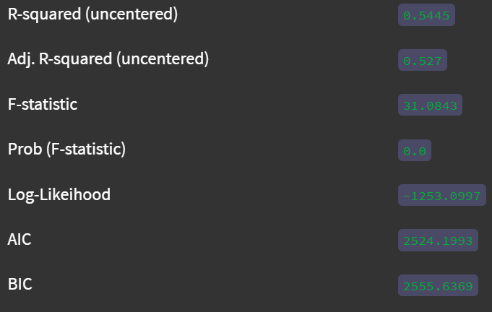
RSBU – PZ 2022-7 Predict Summary

Slide 5
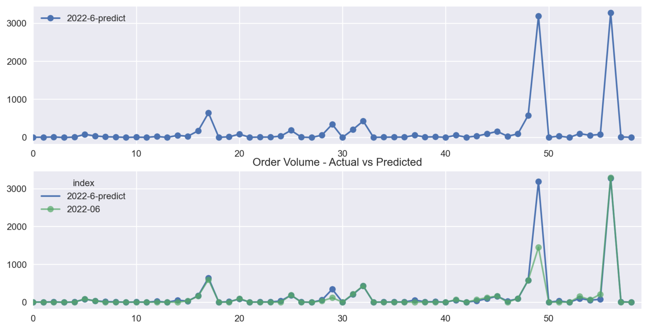
REBU – PA 2022-6 Actual vs Predicted

Slide 6
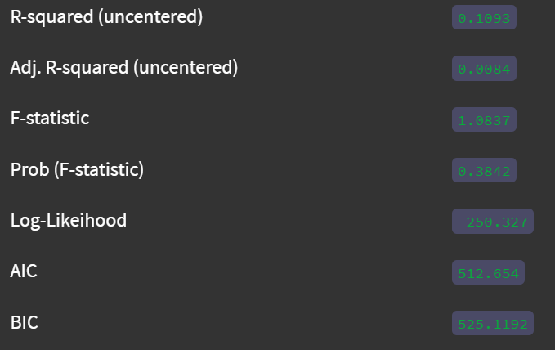
REBU – PA 2022-7 Predict Summary

Slide 7
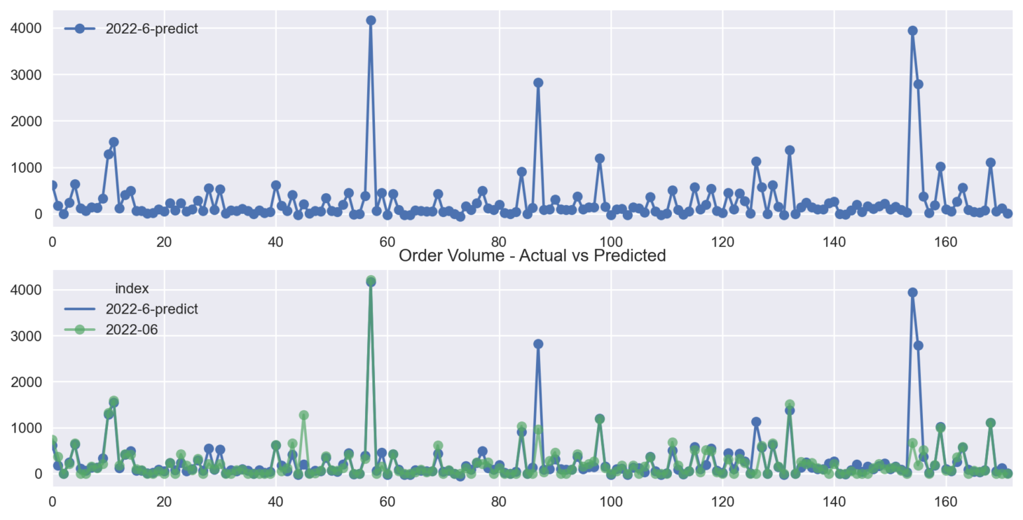
REBU – PVC 2022-6 Actual vs Predicted

Slide 8
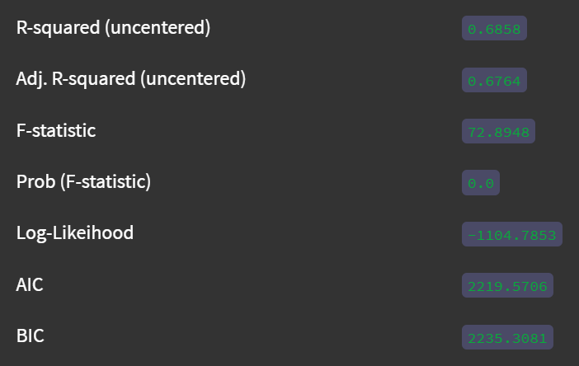
REBU – PVC 2022-7 Predict Summary

Slide 9
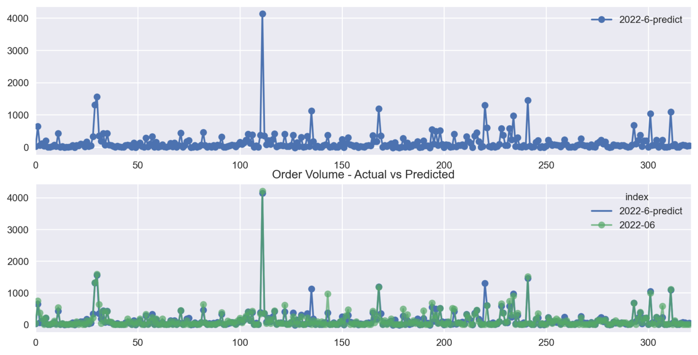
REBU – PZ 2022-6 Actual vs Predicted

Slide 10
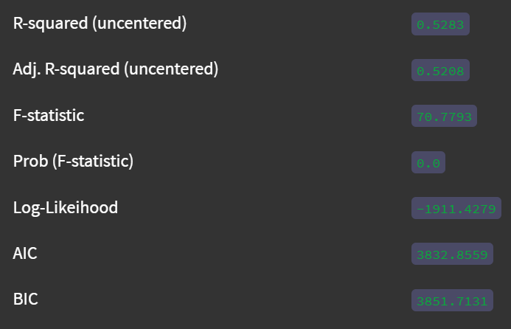
REBU – PZ 2022-7 Predict Summary

Slide 11
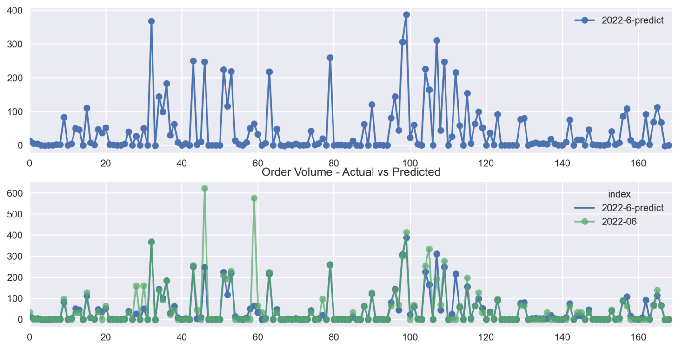
RNBU – PZ 2022-6 Actual vs Predicted

Slide 12
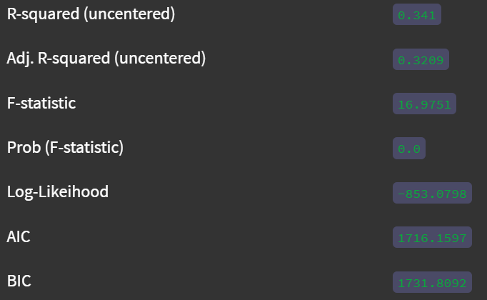
RNBU – PZ 2022-7 Predict Summary

Slide 13
RWBU – PA 2022-6 Actual vs Predicted

Slide 14
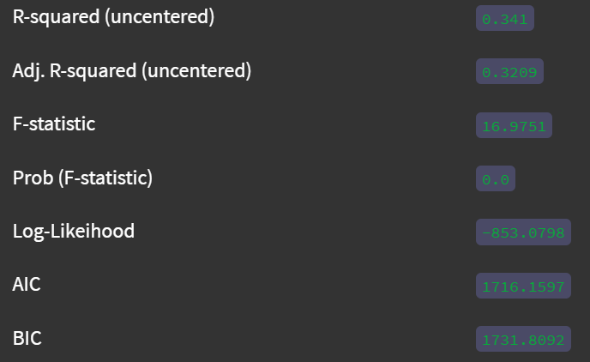
RWBU – PA 2022-7 Predict Summary

Slide 15
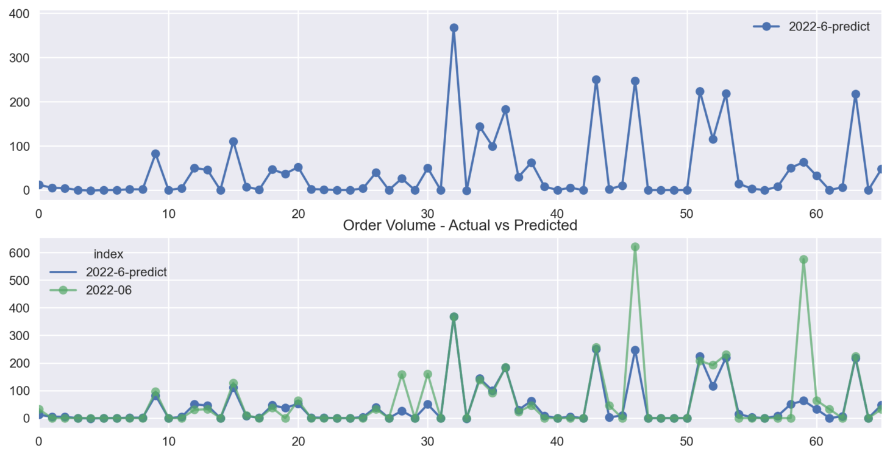
RWBU – PZ 2022-6 Actual vs Predicted

Slide 16
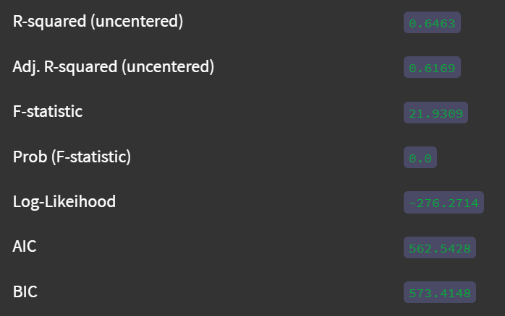
RWBU – PZ 2022-7 Predict Summary

Slide 17
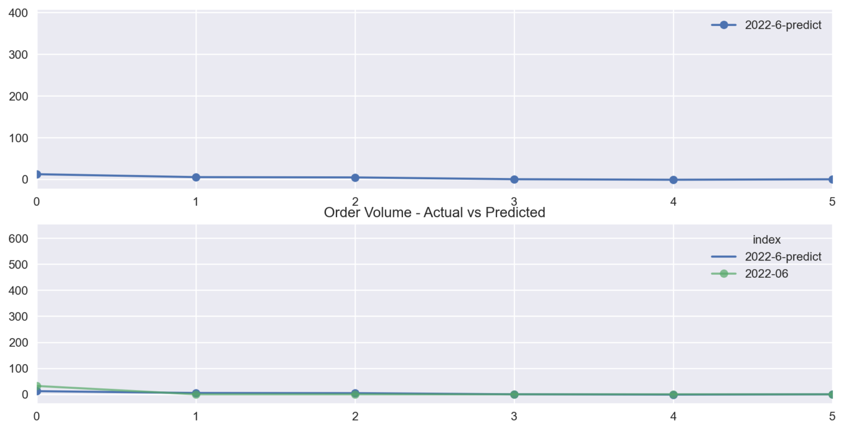
TWBU – PA 2022-6 Actual vs Predicted

Slide 18
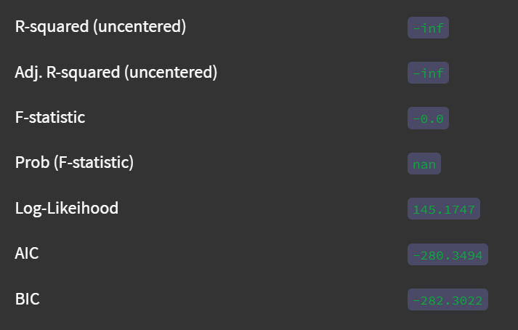
TWBU – PA 2022-7 Predict Summary

Slide 19
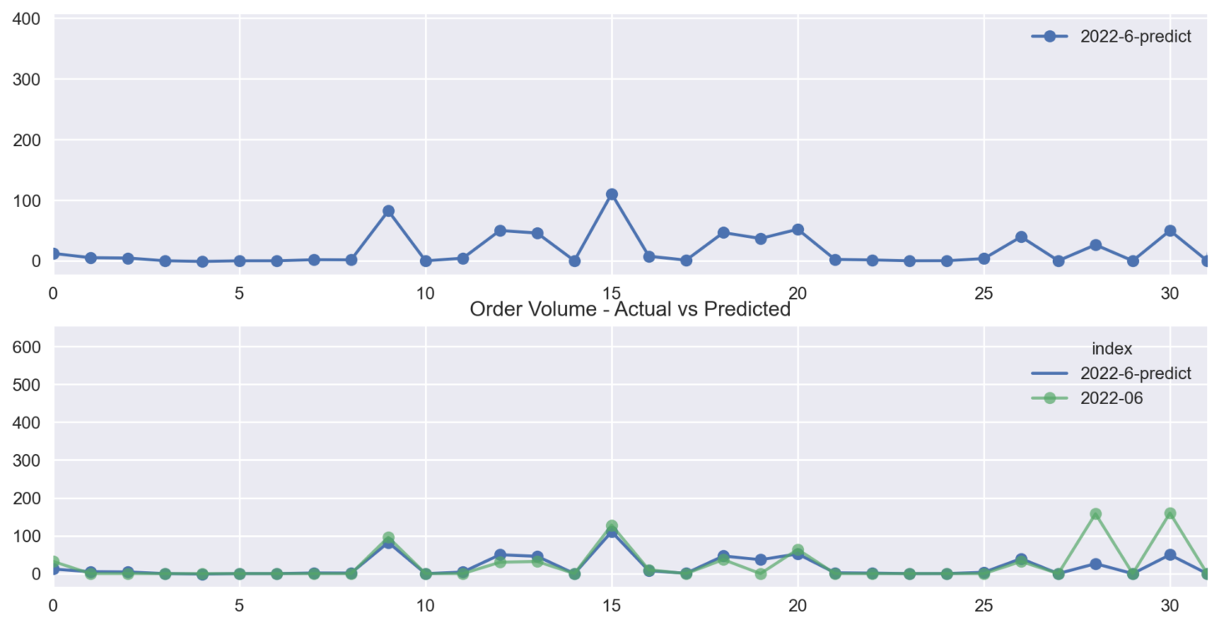
TWBU – PZ 2022-6 Actual vs Predicted

Slide 20
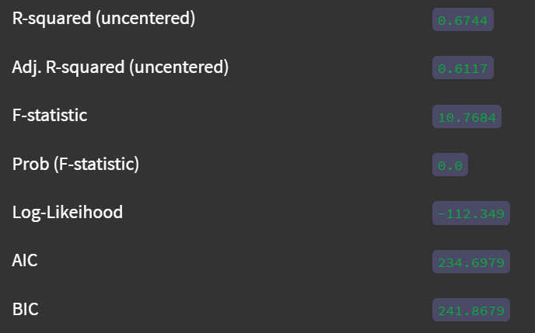
TWBU – PZ 2022-7 Predict Summary

Slide 21
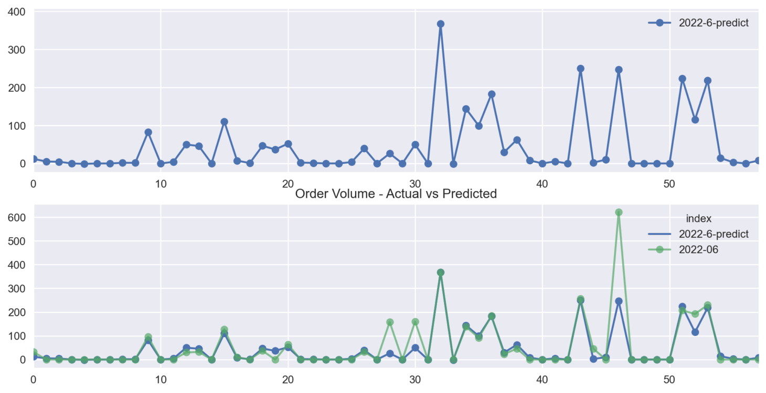
MABU – PZ 2022-6 Actual vs Predicted

Slide 22
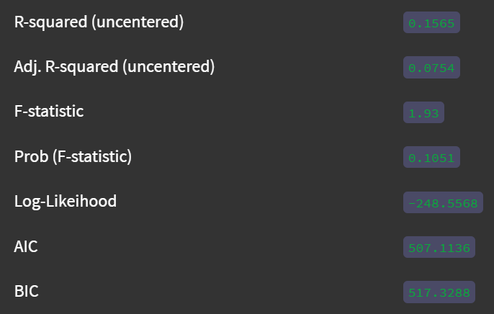
MABU – PZ 2022-7 Predict Summary

